Slide 1
Review-2 on MOVIE TICKET BOOKING APP
2310030045: T. Sai Uday
2310030035: P. Shanmukha Srinivas
2310030450: A. Rahul
2310030307: K. Charan
2310030096: T. Akhil Raj
Under the Guidance of
Dr. A. SIVA KRISHNA REDDY
(Associate Professor)
Computer Science and Engineering Department
KL Hyderabad Off Campus, Aziz Nagar ,Hyderabad

Slide 2
Overview
Introduction
Objectives of the Project
Literature Review
Proposed Methodology/Architecture/Algorithm/Technique/etc
Design (diagrams)
References

Slide 3
Introduction
The increasing demand for easy-to-use digital products has led to the substitution of traditional ticket reservation methods by online ticketing systems for movies. These applications provide users with a simple way of searching for movies, checking showtime, selecting their seats and buying tickets from the comfort of their homes without having to visit a physical ticket counter.
The transformation of the entertainment industry has made it crucial for cinemas and multiplexes to develop self-service booking systems to enhance the user’s experience as well as optimize their management.
The primary aim of a movie booking system application is to provide a convenient, fast and reliable platform through which users can buy their movie tickets. Such applications include features like real time seat availability, online payment options, user authentication and new movie notifications.

Slide 4
With the integration of cloud computing, artificial intelligence and secure payment gateways, these applications provide a convenient and trouble-free ticket booking process. This paper provides a detailed overview of the process of creating, developing and implementing a movie booking system application.
It examines different methodologies, security risks and measures, and ways of enhancing customer service delivery. This study also explores actual implementations and the impact of digitalization on the entertainment industry.

Slide 5
Objectives of the Project
To Design:-
Browse Movie Listings: Allow users to view available movies, their details, showtimes, and theater locations in real time.
Book Movie Tickets: Provide a seamless experience for users to select movies, choose seats, and book tickets based on availability.
Payment Processing: Integrate a secure payment gateway for processing transactions and confirming bookings, supporting multiple payment methods.
Admin Panel: Offer administrators the ability to manage movie listings, showtimes, theaters, and user bookings.

Slide 6
Literature Review
Golden Village Pictures (GVP) has been founded in 1993. It is the top independent movie distributor in Singapore. Entertainment has been witnessed long back in being extremely popular in some of the smaller nations like Singapore and Dubai. GV can be thought of as the pillar of Singapore movie system. It has 11 multiplexes containing 92 screens located at various locations. Golden Village was formed to build and run contemporary, high-end multiplex cinemas and is the first domestic cinema to tailor the movie experience with its Movie Club program. In 2016, GVP released SULLY and PASSENGERS, both of which are produced by Village Roadshow Pictures, and RAILROAD TIGERS of Jackie Chan. If we consider the software side, it employs responsive web designing with Bootstrap. Back end is also supported by SQL database connectivity and PHP. Check buys and Check Booking are two other ticket booking options. Movie voucher code & cards, Shop merchandise, corporate are the remaining modules and functions of the web site. Trailers and posters of the upcoming films have also been displayed on the web site.

Slide 7
Another well-known movie booking web site is Fandango. It's a USA headquarters company booking movie tickets. It offers news such as the latest movie details, theater, box office listings, top box office hits, entertainment news, trailers, videos, search banner and more! Fandango option is one of the possibilities of becoming an authorized fandango user. Booking a movie, Offers are crucial module of web site. The principal flaw of web sites is it only restricts themselves to USA. It is also a PHP based back-end system. There are other different modules. The site supports multiple ads of different websites which include make my trip, clear trip, Flipkart etc. It assists in publicity of the site and also a day ads are one of the chief source of income for all the open source systems. Upcoming movie lists are also well synchronized on this web site and there is even a previous booking system available for the upcoming movie with coupon code. Shopping carts are also available, which includes gift cards also.

Slide 8
Cinema Online is the result of two entrepreneurial minds who share a dream of revolutionizing the Singapore film industry. The site www.cinema.com.my was first brought into existence in October 1998. Since then, it has expanded to comprise thousands of pages of content. Browse and discover all the current developments of films, whether local or global. News, reviews, previews, and contests are among its features. All this from the humble roots of Cinema Show times, now covering nearly ALL Malaysian cinemas, and as ever, updated daily for your convenience. It contains home, movies, charts, features, trailers and show times.

Slide 9
Proposed Methodology/Architecture
If we consider software part, it has already been mentioned that apart from PHP back end support we used NODE JS and Mongo DB connectivity. As speed is the main issue with online system it, the first thing is to sort out this issue and for this use of the stated framework is best alternative. As a matter of fact Node JS and Mongo DB used application is almost thirty times faster than the one which is built with PHP and responsive designing. To get the idea of our system we enacted UML Diagrams as a part of the structure of the whole Movie management system. UML diagrams are used to show the exact architecture and behaviors of the system. UML stands for Unified Modeling Language and it is used in object oriented software engineering. Although typically used in software engineering it is a rich language that can be used to model an application structures, behavior and even business processes. These are usually known to be the Structural Diagrams while there are behavioral Diagrams too. There are lots of UML diagrams which help to get the idea of the existing system like Use Case Diagram, Sequence Diagram, Activity Diagram, and State Chart Diagram.
Out of these we have designed one Class Diagram, Component Diagram and Sequence diagram for Online Movie Booking System. It gives the picture of what is the actual orientation of the system.

Slide 10
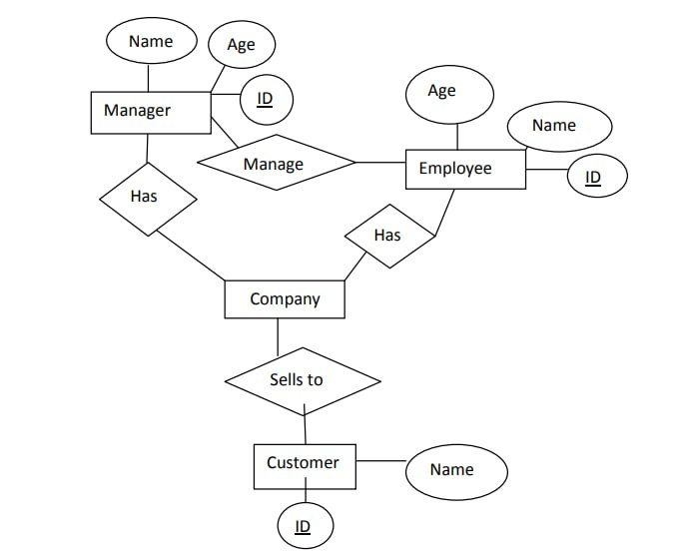
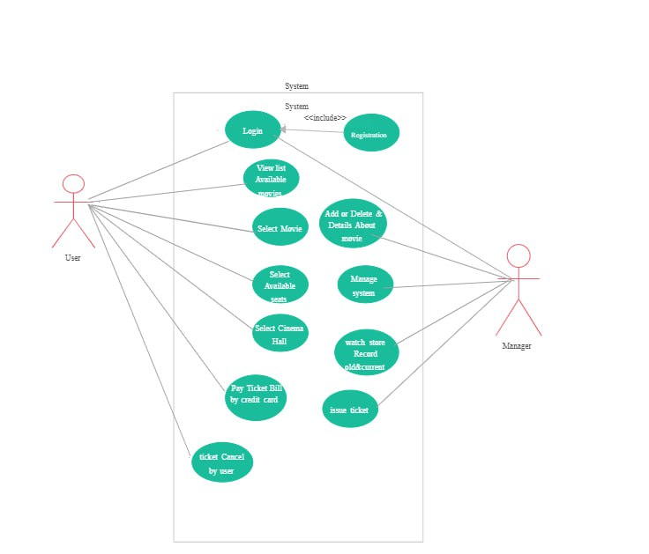
Designs
ER Diagram
Use Case Diagram

Slide 11
References
www.ticketplease.com
www.bookmyshow.com
www.cinemaonline.com
Goel, S., Hofman, J. M., Lahaie, S., Pennock, D. M., & Watts, D. J. (2010). Predicting consumer behavior with Web search. Proceedings of the National academy of sciences, 107(41), 17486-17490
Rishab Jain, C., & Kaluri, R. (2015). Design of automation scripts execution application for Selenium Webdriver and TestNG Framework. ARPN Journal of Engineering and Applied Sciences, 10(6), 2.

Slide 12
Thank you and Any Queries

